Slide 1
Employee Data Analysis using Excel
STUDENT NAME:Haranisha
REGISTER No: 22CZ-A49
DEPARTMENT: COMMERCE ( B.COM GENERAL)
COLLEGE: SHREE CHANDRAPRABHU JAIN COLLEGE, MINJUR

Slide 2
PROJECT TITLE
Employee Performance Analysis using Excel

Slide 3


AGENDA
Problem Statement
Project Overview
End Users
Our Solution and Proposition
Dataset Description
Modelling Approach
Results and Discussion
Conclusion
3/21/2024 Annual Review

Slide 4

PROBLEM STATEMENT
BLEM STATEMENT
1. Inconsistent employee performance data
2. Identifying patterns
3. Employee metrics
4. Decision making
5. Actionable insights

Slide 5

PROJECT OVERVIEW
CONTENT
•AIM; To streamline employee data analysis using excel tools
•OBJECTIVES; Identify key metrics, analyae trends & provide
data – driven insights.

Slide 6

WHO ARE THE END USERS?
•HR mangers
•team leads & departments heds
•company exectives
•company manager

Slide 7

OUR SOLUTION AND ITS VALUE PROPOSITION
CONTENT:
Implement excel- based
data analysis techniques.
Generate automated reports
and dashboards.
Enable easy data
manipulation and visualization

Slide 8
Dataset Description
CONTENT:
Data collected from employee records,including
performance,attendance,& demographics
Number of records,time span,& key variables

Slide 9

THE "WOW" IN OUR SOLUTION
CONTENT:
• automated reporting : our excel based
•system automates complex reporting tasks, saving
•HR managers hours of manual work. Tise enables
•quick access to insightful data withoout the need for
•extensive excel expertise
3/21/2024 Annual Review
9

Slide 10
MODELLING
CONTENT: Data cleaning and preprocessing
Using excel functions for statistical
analysis
Visualization using excel charts and pivot
tables
1
10

Slide 11
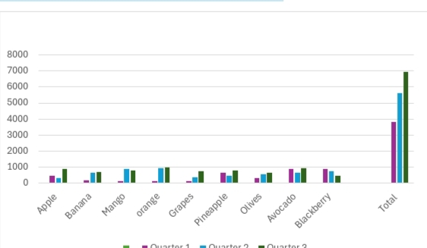
RESULTS
11

Slide 12
conclusion
CONTENT:
Summary of insights gained
impact on decision- making and
empolyee management
Future steps for futher analysis or
implementation

